Slide 1

AUTO VEHICLE
Jan Yalda

Slide 2
Introduction
The problem solved by this project is to have a robotic vehicle that is able to map a random area that its put in autonomously & which also can be controlled by an app as an RC car.

Slide 3
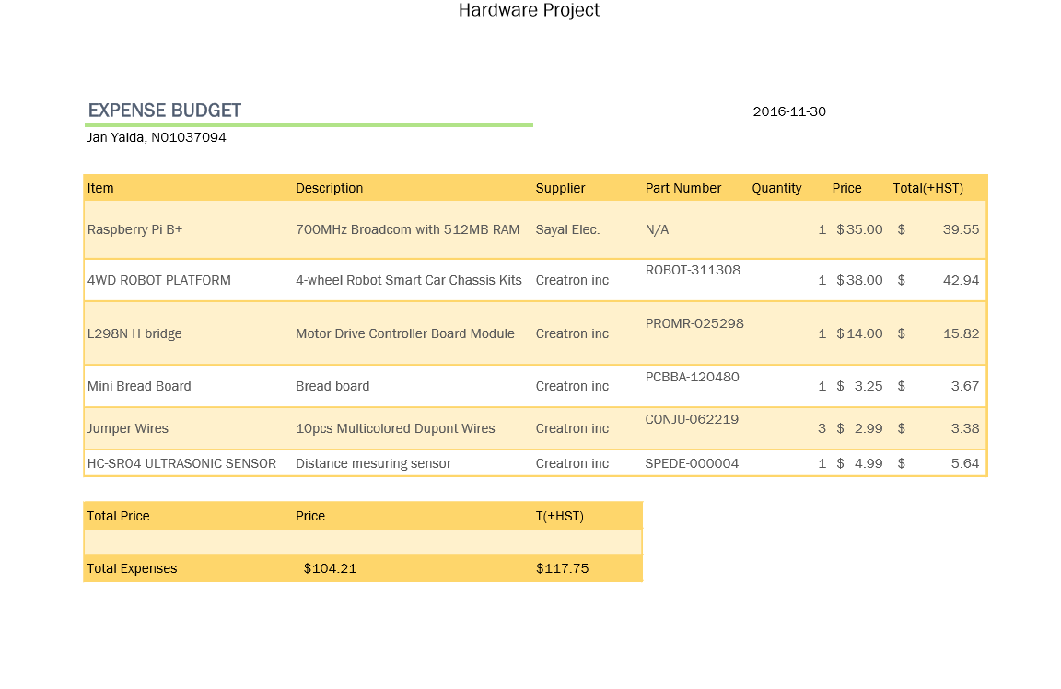
Budget

Slide 4
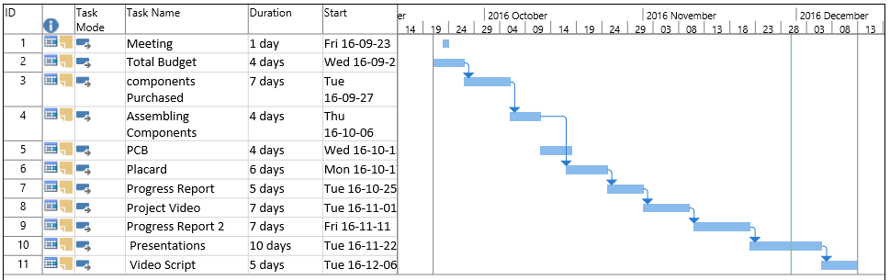
Schedule

Slide 5

Build Video

Slide 6
Course knowledge utilized from previous courses
TECH 101 - Electric Circuits
TECH 150 - Electronic Devices and Circuits
TECH 104 - Programming Fundamentals
WRIT 220 - Technical Workplace Writing Skills
CENG 252 - Embedded Systems
CENG 251- UNIX Internals
CENG 320 - Network Programming

Slide 7
Thanks!

